Slide 1

https://sahibulsaif.wordpress.com/wisdom/bismillah-nature/

Slide 2
Conceptual database modelling
CSC271 – DATABASE SYSTEMS
LECTURE - 05

Slide 3
Today’s Lecture
In this lecture, you will learn about:
Data Models
Conceptual Database Modelling (ER Modelling)

Slide 4
Data Modelling
Process of creating a data model for an information system by applying formal data modeling techniques.
Process used to define and analyze data requirements needed to support the business processes.
Therefore, the process of data modeling involves professional data modelers working closely with business stakeholders, as well as potential users of the information system.

Slide 5
What is Data Model ?
A relatively simple representation, usually graphical, of complex real-world data structures.
A data model visually represents the nature of data, business rules governing the data, and how it will be organized in the database.
A data model provides a way to describe the design of a database at the physical, logical and view levels.
It facilitates interaction among designer, application programmer and end user.

Slide 6
Building Blocks of a Data Model
Entity - anything about which data are to be collected and stored
Attribute - a characteristic of an entity
Relationship - describes an association among entities
One-to-many (1:M) relationship
Many-to-many (M:N or M:M) relationship
One-to-one (1:1) relationship
Constraint - a restriction placed on the data

Slide 7
Data Model Types based on Data Abstraction
American National Standards Institute (ANSI) Standards Planning and Requirements Committee (SPARC)
Defined a framework for data modeling based on degrees of data abstraction(1970s):
External
Conceptual
Internal

Slide 8
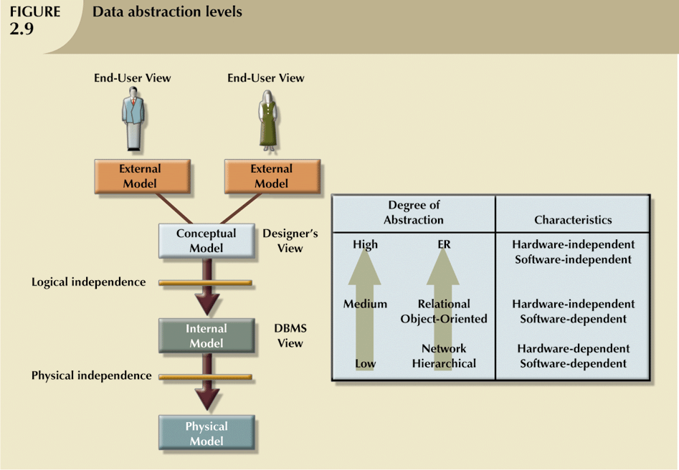
Degrees of Data Abstraction (continued)

Slide 9
External Model
End users’ view of the data environment
Requires that the modeler subdivide set of requirements and constraints into functional modules that can be examined within the framework of their external models

Slide 10
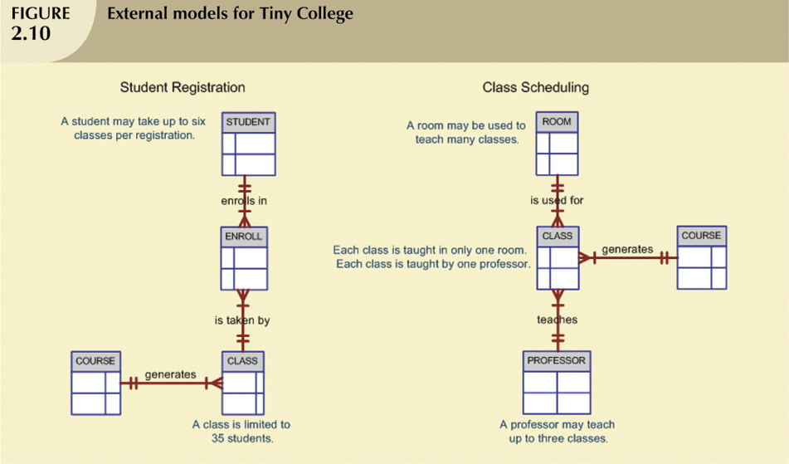

Slide 11
Conceptual Model
Represents global view of the entire database
Representation of data as viewed by the entire organization
Basis for identification and high-level description of main data objects, avoiding details
Most widely used conceptual model is the entity relationship (ER) model

Slide 12
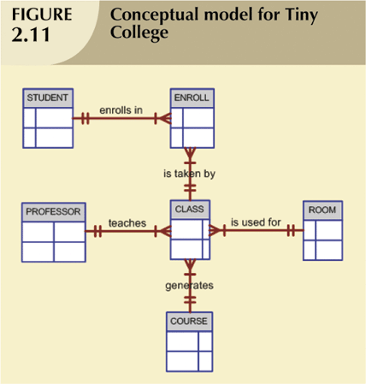
The Conceptual Model (continued)

Slide 13
Conceptual Model
Provides a relatively easily understood macro level view of data environment
Independent of both software and hardware
Does not depend on the DBMS software used to implement the model
Does not depend on the hardware used in the implementation of the model
Changes in either hardware or DBMS software have no effect on the database design at the conceptual level

Slide 14
Internal Model
Representation of the database as “seen” by the DBMS
Maps the conceptual model to the DBMS
Internal schema depicts a specific representation of an internal model

Slide 15
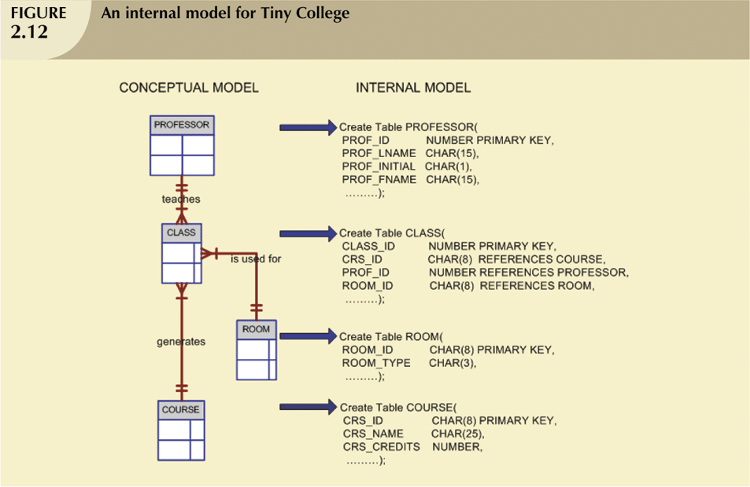
The Internal Model (continued)

Slide 16
Physical Model
Operates at lowest level of abstraction, describing the way data are saved on storage media such as disks or tapes
Software and hardware dependent
Requires that database designers have a detailed knowledge of the hardware and software used to implement database design

Slide 17
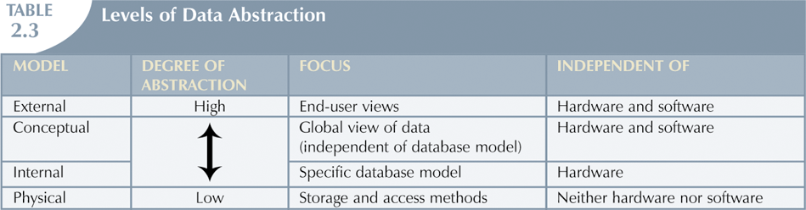
The Physical Model (continued)

Slide 18
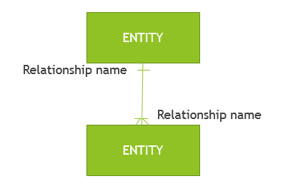
A data model consists of entities related to each other on a diagram:
Data Model Element | Definition
Entity | A real world thing or an interaction between 2 or more real world things.
Attribute | The atomic pieces of information that we need to know about entities.
Relationship | How entities depend on each other in terms of why the entities depend on each other (the relationship) and what that relationship is (the cardinality of the relationship).

Slide 19
Example:
Given that …
“Customer” is an entity.
“Product” is an entity.
For a “Customer” we need to know their “customer number” attribute and “name” attribute.
For a “Product” we need to know the “product name” attribute and “price” attribute.
“Sale” is an entity that is used to record the interaction of “Customer” and “Product”.

Slide 20
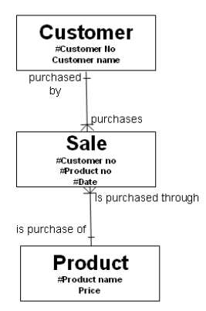
Think of entities as tables, think of attributes as columns on the table and think of instances as rows on that table

Slide 21
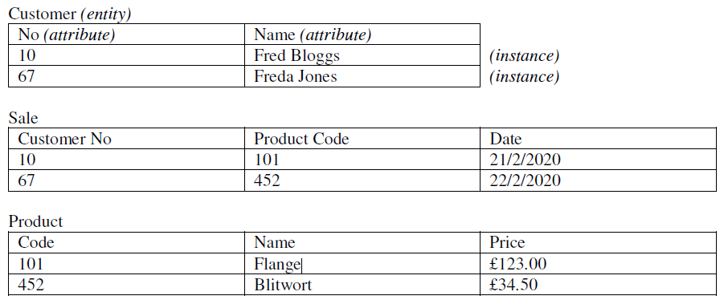
If we want to know the price of a Sale, we can ‘find’ it by using the “Product Code” on the instance of “Sale” we are interested in and look up the corresponding “Price” on the “Product” entity with the matching “Product Code”.

Slide 22

http://www.thomasformo.com/category/qa/

